Slide 1
Organizational Behavior
Notes:
Cover Image: "Untitled." Authored by: StartupStockPhotos. Provided by: Pixabay. Located at: https://pixabay.com/en/ideation-startup-entrepreneur-3267505/. Content Type: CC Licensed Content, Shared Previously. License: CC0: No Rights Reserved.
All text in these slides is taken from https://courses.lumenlearning.com/wmopen-organizationalbehavior/ where it is published under one or more open licenses.
All images in these slides are attributed in the notes of the slide on which they appear and licensed as indicated.

Slide 2
Module Learning Outcomes
Describe the field of organizational behavior and discuss its relevance to the workplace
1.1: Describe the general history of management theory and practice and frame how organizational behavior has developed from these into a discreet field
1.2: Describe organizational behavior and differentiate between the three levels of influence
1.3: Describe contemporary issues and topics in organizational behavior

Slide 3
Management Theory and Organizational Behavior

Slide 4
Early Management Theories (early 1900s)
Scientific Management Theory (Taylor, 1880-1910)
Championed the efficient and effective completion of tasks
The primary goal of scientific management is to increase efficiency. When Taylor began his scientific management experiments, he focused on increasing efficiency by reducing the amount of time needed to perform tasks.
The Principles of Scientific Management
Choose methods based on science: Use the scientific method to determine the most efficient way to complete a task. Focus on increasing productivity and profits.
Assign workers to tasks based on their natural skillset: Get to know your workers, discover what they’re good at, and place them where their skills will be the most useful.
Monitor your workers’ performance: Observe what your workers are doing while they are on the clock so that you can quickly address any problems. If some workers are confused or unproductive, it is up to their managers to step in and fix the issue.
Divide workloads appropriately between workers and managers: Make sure that managers understand how to plan and train workers and that workers understand how to implement those plans.

Slide 5
Administrative Management Theory (Fayol)
Fourteen pillars for organizational strength and health
Division of Work.
Authority.
Discipline.
Unity of Command.
Unity of Direction.
Collective Interest Over Individual Interest.
Remuneration.
Centralization.
Scalar Chain.
Order
Equity.
Stability of Tenure of Personnel.
Initiative.
Esprit de Corps.
Fayol's Five Functions of Management
Planning: the need "to assess the future and make provision for it." That includes a flexible action plan that considers a firm's resources, work in progress, and future market trends.
Organizing: laying out lines of authority and responsibility for employees. This covers recruitment and training, coordinating activities, and making employees' duties clear.
Commanding: getting the most from people. So, managers must know their employees' skills, delegate to tap into these skill sets, and set a good example.
Coordinating: in a well-coordinated organization, departments know their responsibilities, the needs of other teams, and their obligations to them.
Controlling: continually checking that rules, plans and processes are working as well as they should be.

Slide 6
Bureaucratic Management Theory (Weber)
Encouraged detailed company objectives and division of labor
Max Weber, born in western Germany and educated in law at Heidelberg,
Weber’s bureaucratic theory argues that bureaucracies are highly structured, emotionless, and well-organized organizations.
Structured Hierarchy: In a bureaucratic organization, each level governs the one beneath it, creating a formal hierarchy that serves as the basis for central planning and decision-making.
Rule-Based Management: The organization maintains control through the implementation of rules, ensuring seamless execution of decisions by lower levels under the guidance of higher levels.
Functional Specialization: Work is delegated to specialists, often organized into groups based on their specific tasks or skills.
Up-Focused or In-Focused: The organization’s orientation is either up-focused, aiming to represent external entities like shareholders or boards, or in-focused, focused on serving the company itself and internal stakeholders, such as generating income.
Impersonal: Hierarchical organizations treat all employees and clients impartially, avoiding the influence of individual differences.
Employment-oriented Professional Qualifications: Selection and promotion within the organization are based on technical qualifications, skills, and professional expertise.

Slide 7
Human Relations Management Theory/The Hawthorne Effect (Elton Mayo)
Human Relations Management Theory/The Hawthorne Effect (Elton Mayo)
Human interaction and management influences productivity
During the 1920s, a series of studies that marked a change in the direction of motivational and managerial theory was conducted by Elton Mayo on workers at the Hawthorne plant of the Western Electric Company in Illinois.
The social and psychological factors at the workplace, not the physical conditions of the workplace determine the employees’ morale and output.
b) The organization is a social system.
c) Non-economic rewards and sanctions significantly affect the workers’ behaviour, morale and
output.
d) Workers are not inert or isolated, unrelated individual; they are social animals.
e) Division of labour strictly on specialization is not necessarily the most efficient approach.
f) The workers have a tendency to form small groups (informal organizations). The production normsand behavioural patterns are set by such groups.
g) Leadership, style of supervision, communication and participation play a central role in workers’ behaviour, satisfaction and productivity

Slide 8
Later Management Theories (1920–1960)
X&Y Management Theory (McGregor)
X management approach – employees are inherently lazy, hate work
Y management approach – employees are internally motivated
In the 1960s, social psychologist Douglas McGregor developed two contrasting theories that explained how managers' beliefs about what motivates their people can affect their management style. He labeled these Theory X and Theory Y. These theories continue to be important even today.

Slide 9
Organizational Behavior (1970s)
Organizational Behavior
Scientific Management Theory
Administrative Management Theory
Bureaucratic Management Theory
Human Relations Theory
Systems Theory
X&Y Management Theory

Slide 10
Organizational Behavior as Its Own Field

Slide 11
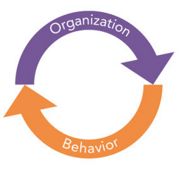
Understanding Organizational Behavior
The academic study of an organization through the behavior of its members
Intended to explain behavior and make behavioral predictions
Incorporates components of management, psychology, leadership, personality traits, motivation, etc.
Notes:
Image: Organizational Behavior. Provided by: Lumen Learning. License: CC BY: Attribution

Slide 12



Three levels of influence
The individual
The group
The organization
Notes:
Male Black Stick Figure. Authored by: Clker-Free-Vector-Images. Provided by: Pixabay. Located at: https://pixabay.com/vectors/man-boy-male-black-stick-figure-296526/
. License: CC0: No Rights Reserved. License Terms: Pixabay License

Slide 13
Personality and Behavior in the Workplace

Slide 14
Personality
Character
The outer appearance and behavior of a person
Personality traits can change with time
Often the focus of business, to determine if a new hire fits in with culture, etc.
Examples of personality traits:
Outgoing
Funny
Quiet
Talkative
A set of moral and mental qualities and beliefs, that makes a person different from others
Indicates the traits of a person which are hidden from sight
Requires knowing the individual for some time
Examples of character traits:
Loyalty
Honesty
Kindliness

Slide 15
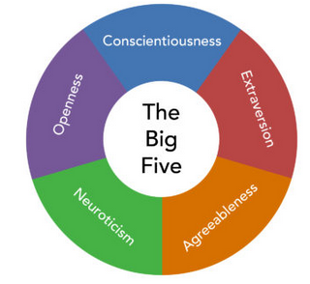
Personality Testing
Myers-Briggs
Extrovert vs. introvert
Sensing vs. intuition
Thinking vs. feeling
Judging vs. perceiving
The Big Five (OCEAN)
Openness
Conscientiousness
Extraversion
Agreeableness
Neuroticism
Notes:
Image: The Big Five. Provided by: Lumen Learning. License: CC BY: Attribution

Slide 16
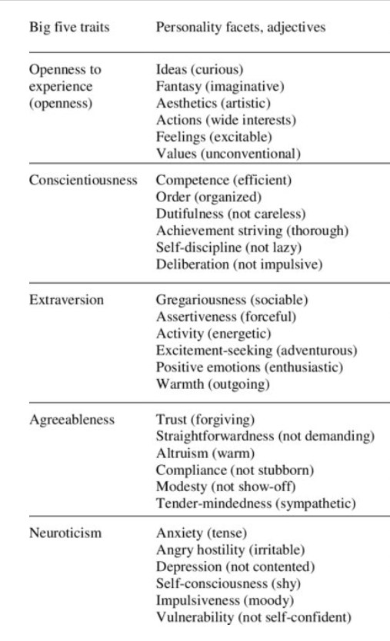
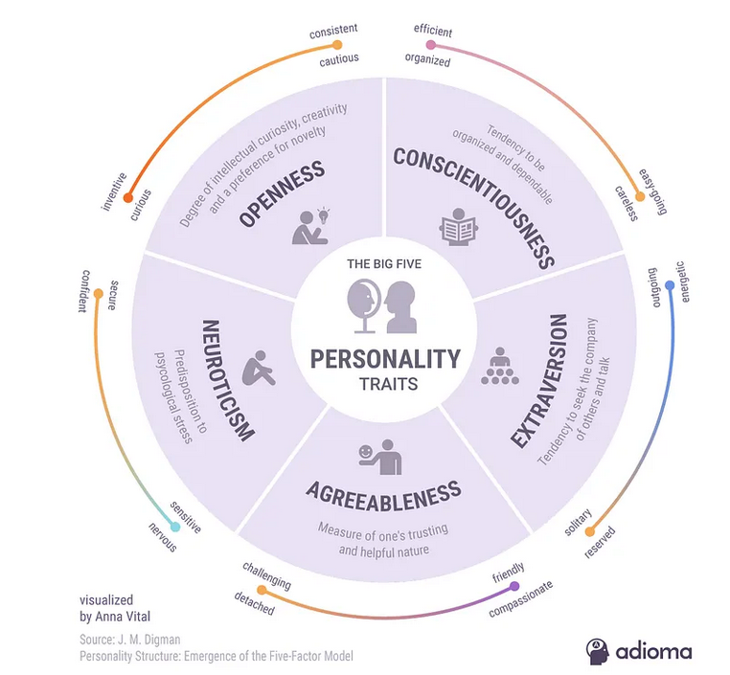
Big Five Personality Traits

Slide 17

Personality and Behavior
Personality influences behavior
Personality traits are on a spectrum, and the more extreme an individual is on that spectrum, the easier the behavior is to predict.
Observing behavior in different scenarios helps predict response
Notes:
Untitled. Authored by: AbsolutVision. Provided by: Pixabay. Located at: https://pixabay.com/photos/smiley-emoticon-anger-angry-2979107/. License: CC0: No Rights Reserved. License Terms: Pixabay License

Slide 18
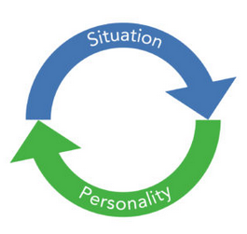
Situation Affects Behavior
Situations can influence an individual’s personality.
An individual’s personality paired with the situation can help to predict behavior.
Notes:
Image: Personality and Situation. Provided by: Lumen Learning. License: CC BY: Attribution

Slide 19

Individuality vs. Conformity
Organizations support individuality to increase job satisfaction
Organizations command some conformity to ensure productivity and output
Management by Objective (SMART goals)
Competency models
Notes:
Hat Fashion Style. Authored by: Ryan McGuire. Provided by: Pixabay. Located at: https://pixabay.com/photos/hat-fashion-style-happy-man-591973/. License: CC0: No Rights Reserved. License Terms: Pixabay License

Slide 20
Individualized Management
Individualized management includes
Employees choosing their own hours
Employees wearing what they want
Encourage employees to develop their own brand
Employs people from different cultures
Employs people with different intellectual levels
Employs people with different skills and interests
Notes:
Untitled. Authored by: Gerd Altmann. Provided by: Pixabay. Located at: https://pixabay.com/illustrations/head-face-talk-communication-mask-927180/. License: CC0: No Rights Reserved. License Terms: Pixabay License

Slide 21
Organizational Culture
Notes:
Cover Image: "Untitled." Authored by: StartupStockPhotos. Provided by: Pixabay. Located at: https://pixabay.com/en/ideation-startup-entrepreneur-3267505/. Content Type: CC Licensed Content, Shared Previously. License: CC0: No Rights Reserved.
All text in these slides is taken from https://courses.lumenlearning.com/wmopen-organizationalbehavior/ where it is published under one or more open licenses.
All images in these slides are attributed in the notes of the slide on which they appear and licensed as indicated.

Slide 22

What is organizational culture?
Sets the tone for an organization
Defines acceptable behavior
Formed by organization’s values and beliefs
Outlines organizational procedures
Notes:
Group of People Forming Star on Their Hands. Authored by: rawpixel. Provided by: Pexels. Located at: https://www.pexels.com/photo/adult-african-american-woman-business-businessmen-1056561/. License: CC0: No Rights Reserved.

Slide 23
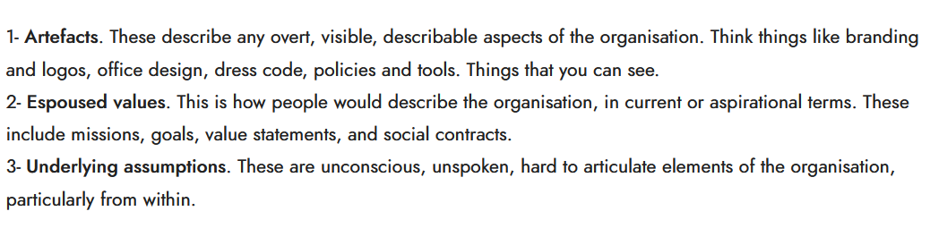
Levels of Organizational Culture (Schein)
Discursive (Values)
Affective and cognitive (underlying assumptions)
Symbolic (Artifacts)

Slide 24

External Factors Impacting Culture
Political factors
Economic factors
Industry factors
Social factors
Technology factors
Notes:
Untitled. Authored by: Stocksnap. Provided by: Pixabay. Located at: https://pixabay.com/photos/people-woman-rally-protest-unite-2575608/. License: CC0: No Rights Reserved. License Terms: Pixabay License

Slide 25

Internal Factors Impacting Culture
Employees
Leadership
Capability and Support
Nature of Business
Resources and Technology
Notes:
Eggs in Tray on White Surface. Authored by: David Reche. Provided by: Pexels. Located at: https://www.pexels.com/photo/eggs-in-tray-on-white-surface-1556707/. License: CC0: No Rights Reserved.

Slide 26

Developing and Maintaining a Culture
Vision statement
Mission statement
Code of ethics/Value statement
Policies and procedures
Notes:
Selective Focus Photography of Beige Orange Red and Green Blocks Piled Vertically. Authored by: Marcus Spiske. Provided by: Pexels. Located at: https://www.pexels.com/photo/playing-child-childhood-toy-105855/. License: CC0: No Rights Reserved.

Slide 27
Workplace Design
Taylorism - Taylorism office spaces were large rooms with wall to wall tables where people worked directly next to each other. Managers monitored the room from their offices which surrounded the large working spaces. The entire motivation around the Taylorism office spaces was to increase productivity.
Burolandschaft (“office landscape”) - A more open workplace, allowing employees and managers alike to socialize more easily. Burolandschaft was intended to replace a rigid office design with a more organic and natural vibe. Partitions were replaced with plants and the walkways through the office were reimagined to promote socialization.
Cubicle farm - Cubicles were inexpensive and allowed organizations to compact employees together in smaller spaces with the hopes of minimizing overhead costs and maximizing productivity. Cubicles created tiny work spaces for employees and minimized visibility and ease of interaction between coworkers.
Open workspaces - Open work spaces with multiple seating options but no individually dedicated workspace is a popular trend today. Fun activities have also been incorporated into the work space including video games, bikes, foosball, pool, rock climbing walls, etc. While some may view these as distractions, others view them as helpful brain breaks that allow employees a chance to decompress.
Notes:
Man Sitting on Gray Chair. Authored by: Startup Photos. Provided by: Pexels. Located at: https://www.pexels.com/photo/desk-office-workspace-coworking-7110/. License: CC0: No Rights Reserved.

Slide 28
Quick Review
Organizational culture sets the tone for acceptable behavior within its operations with its values, mission, vision and code of ethics
There are, according to Schein, four levels of organizational culture
External influences on culture include politics, economics, technology, and more
Employees, leadership, resources and capability are among those internal factors that can influence culture
Workplace design can often influence culture

Slide 29
Organizational Behavior
Module 6: Motivation in the Workplace
Notes:
Cover Image: "Untitled." Authored by: StartupStockPhotos. Provided by: Pixabay. Located at: https://pixabay.com/en/ideation-startup-entrepreneur-3267505/. Content Type: CC Licensed Content, Shared Previously. License: CC0: No Rights Reserved.
All text in these slides is taken from https://courses.lumenlearning.com/wmopen-organizationalbehavior/ where it is published under one or more open licenses.
All images in these slides are attributed in the notes of the slide on which they appear and licensed as indicated.

Slide 30
Module Learning Outcomes
Discuss theories of motivations and strategies to improve motivation in the workplace
6.1: Describe how "motivation" operates in organizational behavior
6.2: Describe various theories of motivation
6.3: Discuss impact of motivation in the workplace

Slide 31
Motivation in Organizational Behavior

Slide 32
Learning Outcomes: Motivation in Organizational Behavior
6.1: Describe how "motivation" operates in organizational behavior
6.1.1: Describe motivation
6.1.2: Discuss the individual components of motivation
6.1.3: Discuss the work components of motivation
6.1.4: Discuss the organizational components of motivation

Slide 33
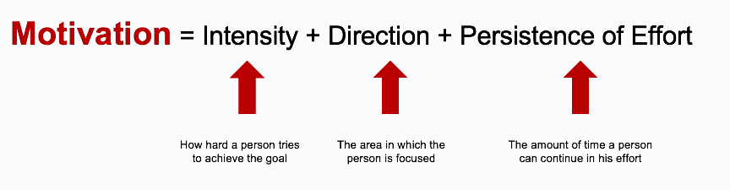
Define motivation

Slide 34
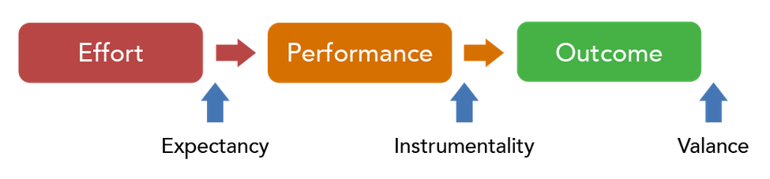
Motivation at Work: The Expectancy Framework
Notes:
Image: The Expectancy Framework. Provided by: Lumen Learning. License: CC BY: Attribution

Slide 35
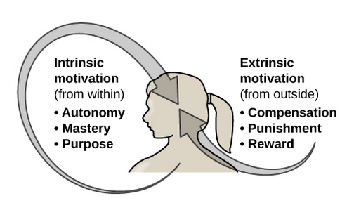
Intrinsic vs. Extrinsic Motivation
Notes:
Image: Intrinsic versus Extrinsic Motivation. Provided by: OpenStax CNX. Located at: https://cnx.org/contents/Sr8Ev5Og@10.16:MLADqXMi@11/10-1-Motivation. License: CC BY: Attribution. License Terms: Download for free at http://cnx.org/contents/4abf04bf-93a0-45c3-9cbc-2cefd46e68cc@10.16

Slide 36
Locus of Control and Self-Esteem
Notes:
Image: Locus of Control. Provided by: Lumen Learning. License: CC BY: Attribution

Slide 37


Also to be considered…
Employee Needs
Cultural Differences
Notes:
Four People Holding Signage. Authored by: rawpixel. Provided by: Pexels. Located at: https://www.pexels.com/photo/four-people-holding-signage-1656594/. License: CC0: No Rights Reserved.
Two Person Standing Near Assorted-color Paper Lanterns. Authored by: Min An. Provided by: Pexels. Located at: https://www.pexels.com/photo/two-person-standing-near-assorted-color-paper-lanterns-1313814/. License: CC0: No Rights Reserved.

Slide 38
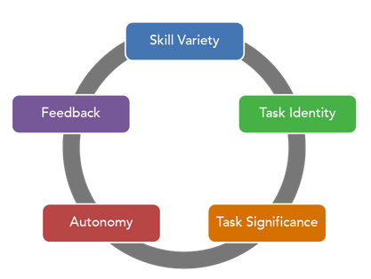
Job Design
Managers should tailor jobs to meet employee needs by striking a balance of these five elements
The right combination of these elements can serve the individual’s intrinsic motivations
Notes:
Image: Job Design Model. Authored by: Freedom Learning Group. Provided by: Lumen Learning. License: CC BY: Attribution

Slide 39


Training and Working Conditions
Notes:
Discuss how training and working conditions can serve as motivators (and demotivators) for employees
Office Training. Authored by: Mohammed Hussan. Provided by: Pixabay. Located at: https://pixabay.com/illustrations/training-training-course-3185170/. License: CC0: No Rights Reserved. License Terms: Pixabay License
Person in Welding Mask While Welding a Metal Bar. Authored by: Pixabay. Provided by: Pexels. Located at: https://www.pexels.com/photo/industry-metal-fire-radio-73833/. License: CC0: No Rights Reserved.

Slide 40
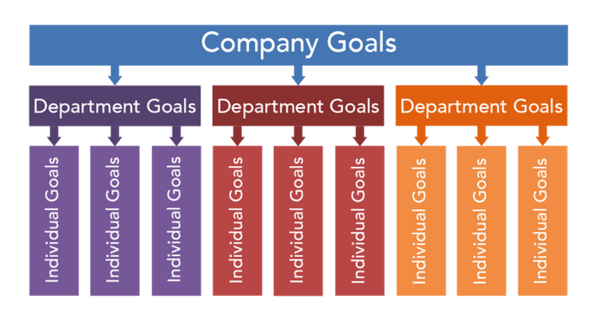
Goal Setting
Management by Objective (MBO)
Goals should be
Specific
Measurable
Attainable
Reasonable
Time-bound or time-specific
Notes:
Image: Goal Setting. Authored by: Freedom Learning Group. Provided by: Lumen Learning. License: CC BY: Attribution

Slide 41

Corporate Culture
Benefits
Fosters teamwork
Encourages wellness
Disadvantage
Company Politics
Gossip
Notes:
Untitled. Authored by: Gerd Altmann. Provided by: Pixabay. Located at: https://pixabay.com/illustrations/hands-finger-touch-team-teamwork-1691221/. License: CC0: No Rights Reserved. License Terms: Pixabay License

Slide 42


Leaders and Co-workers
Notes:
Group of People Playing Uno Cards. Authored by: rawpixel. Provided by: Pexels. Located at: https://www.pexels.com/photo/adult-business-choices-choosing-515169/. License: CC0: No Rights Reserved.
Untitled. Authored by: www_slon_pics. Provided by: Pixabay. Located at: https://pixabay.com/photos/businessman-man-afraid-angry-3036181/. License: CC0: No Rights Reserved. License Terms: Pixabay License

Slide 43

Equity
An employee’s sense that everyone is being treated fairly and the same as one another
Notes:
Untitled. Authored by: 3dman_eu. Provided by: Pixabay. Located at: https://pixabay.com/illustrations/horizontal-justice-right-law-1010894/. License: CC0: No Rights Reserved. License Terms: Pixabay License

Slide 44
Theories of Motivation

Slide 45
Learning Outcomes: Theories of Motivation
6.2: Describe various theories of motivation
6.2.1: Explain the role of the Hawthorne effect in management
6.2.2: List the various levels of needs in Maslow's hierarchy
6.2.3: Summarize the changes to Maslow's hierarchy of needs in Alderfer's ERG theory
6.2.4: Describe how employees might be motivated using McClelland's acquired needs theory
6.2.5: Differentiate between Theory X and Theory Y
6.2.6: Explain the difference between intrinsic and extrinsic motivators in Herzberg's two-factor theory

Slide 46
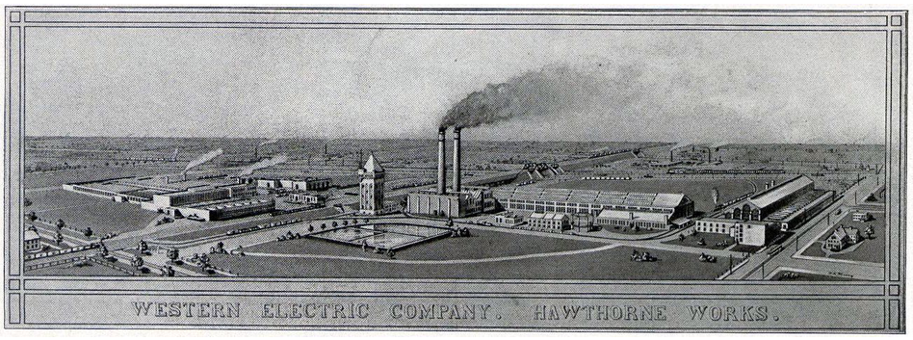
The Hawthorne Effect (1920s)
What you need to know:
Job satisfaction and social issues impact productivity more than pay and working conditions
Notes:
Hawthorne Works. Provided by: Western Electric Company. Located at: https://commons.wikimedia.org/wiki/File:Hawthorne_Works_aerial_view_ca_1920_pg_2.jpg. License: Public Domain: No Known Copyright

Slide 47
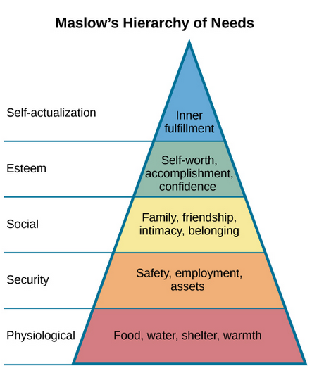
Maslow’s Hierarchy
What you need to know:
Maslow depicted five levels of human need and declared that they needed to be fulfilled in order (from the foundation up)
Notes:
Image: Maslow's Hierarchy of Needs. Provided by: OpenStax CNX. Located at: http://cnx.org/contents/Sr8Ev5Og@5.52:MLADqXMi@5/Motivation. License: CC BY: Attribution. License Terms: Download for free at http://cnx.org/contents/4abf04bf-93a0-45c3-9cbc-2cefd46e68cc@5.48

Slide 48
Aldefer’s ERG Theory - Clayton Paul Alderfer
Alderfer’s ERG theory suggests that there are three groups of core needs: existence (E), relatedness (R), and growth (G)—hence the acronym ERG. These groups align with Maslow’s levels of physiological needs, social needs, and self-actualization needs, respectively.
Existence needs - concern our basic material requirements for living. These include what Maslow categorized as physiological needs (such as air, food, water, and shelter) and safety-related needs (such as health, secure employment, and property).
Relatedness needs - the importance of maintaining interpersonal relationships. These needs are based in social interactions with others and align with Maslow’s levels of love/belonging-related needs (such as friendship, family, and sexual intimacy) and esteem-related needs (gaining the respect of others).
Growth - needs describe our intrinsic desire for personal development. These needs align with the other portion of Maslow’s esteem-related needs (self-esteem, self-confidence, and achievement) and self-actualization needs (such as morality, creativity, problem-solving, and discovery).
Existence
Relatedness
Growth

Slide 49
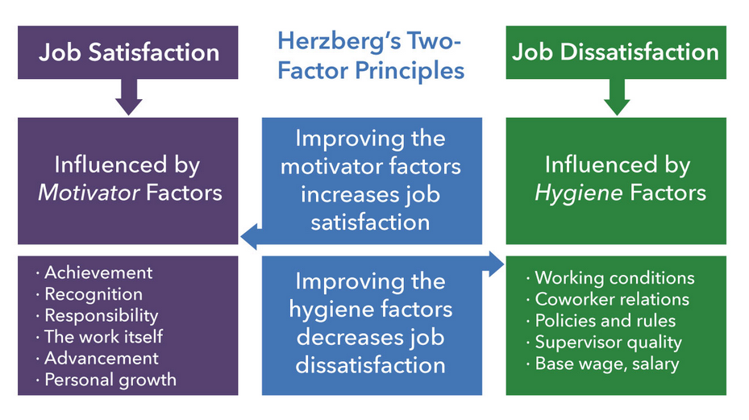
Herzberg’s Motivation-Hygiene Theory - “Two Factor Theory”

Slide 50
McClelland’s Acquired Needs Theory
David McClelland suggested three human needs operated all at the same time
Individuals are motivated by the strength or level of each need
Three categories of needs:
Achievement - Employees who are strongly achievement-motivated are driven by the desire for mastery. They prefer working on tasks of moderate difficulty in which outcomes are the result of their effort rather than luck. They value receiving feedback on their work.
Affiliation - Employees who are strongly affiliation-motivated are driven by the desire to create and maintain social relationships. They enjoy belonging to a group and want to feel loved and accepted. They may not make effective managers because they may worry too much about how others will feel about them.
Power - Employees who are strongly power-motivated are driven by the desire to influence, teach, or encourage others. They enjoy work and place a high value on discipline. However, they may take a zero-sum approach to group work—for one person to win, or succeed, another must lose, or fail. If channeled appropriately, though, this can positively support group goals and help others in the group feel competent.

Slide 51
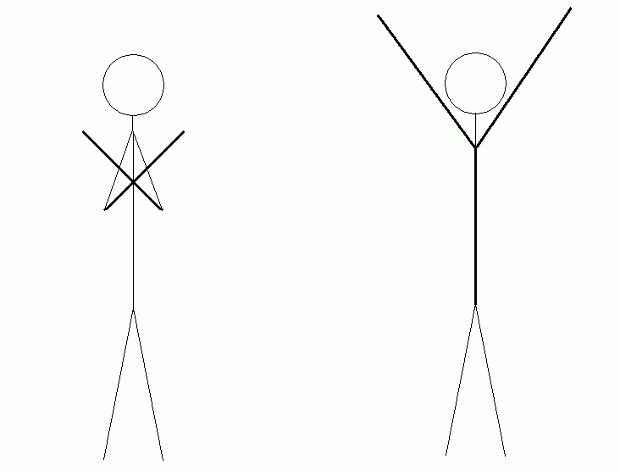
McGregor’s Theory X and Theory Y
Theory X
Employees don’t like to work
They must be threatened into productivity
Theory Y
Employees naturally embrace responsibility and creativity
They will be productive and self-directed
Notes:
Image: McGregor XY Languages. Provided by: Martin Adámek. Located at: https://commons.wikimedia.org/wiki/File:McgregorXY-languages_(cropped).gif. License: CC BY: Attribution.

Slide 52
Theory X - assumptions
Theory X management assumes the following:
Work is inherently distasteful to most people, and they will attempt to avoid work whenever possible.
Most people are not ambitious, have little desire for responsibility, and prefer to be directed.
Most people have little aptitude for creativity in solving organizational problems.
Motivation occurs only at the physiological and security levels of Maslow’s hierarchy of needs.
Most people are self-centered. As a result, they must be closely controlled and often coerced to achieve organizational objectives.
Most people resist change.
Most people are gullible and unintelligent.
Essentially, Theory X assumes that the primary source of employee motivation is monetary, with security as a strong second. Under Theory X, one can take a hard or soft approach to getting results.

Slide 53
Theory Y - assumptions
Work can be as natural as play if the conditions are favorable.
People will be self-directed and creative to meet their work and organizational objectives if they are committed to them.
People will be committed to their quality and productivity objectives if rewards are in place that address higher needs such as self-fulfillment.
The capacity for creativity spreads throughout organizations.
Most people can handle responsibility because creativity and ingenuity are common in the population.
Under these conditions, people will seek responsibility.
Under these assumptions, there is an opportunity to align personal goals with organizational goals by using the employee’s own need for fulfillment as the motivator. McGregor stressed that Theory Y management does not imply a soft approach.

Slide 54
Theory Y approach
Decentralization and delegation: If firms decentralize control and reduce the number of levels of management, managers will have more subordinates and consequently need to delegate some responsibility and decision making to them.
Job enlargement: Broadening the scope of an employee’s job adds variety and opportunities to satisfy ego needs.
Participative management: Consulting employees in the decision-making process taps their creative capacity and provides them with some control over their work environment.
Performance appraisals: Having the employee set objectives and participate in the process of self-evaluation increases engagement and dedication.

Slide 55
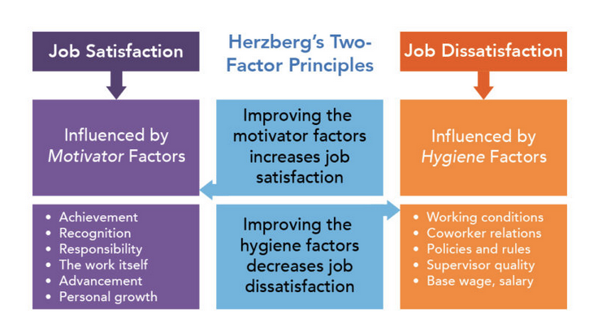
Herzberg’s Two-Factor Theory
Notes:
Image: Modification of Herzberg's Two-Factor Principles. Provided by: Boundless; Modification by Lumen Learning. Located at: https://courses.lumenlearning.com/boundless-management/. License: CC BY-SA: Attribution-ShareAlike

Slide 56
Motivation in the Workplace

Slide 57
Management by Objective (MBO)
Notes:
Image: Goal Setting. Authored by: Freedom Learning Group. Provided by: Lumen Learning. License: CC BY: Attribution

Slide 58

Employee Recognition Programs
Personal and team recognition
Public or private recognition
Notes:
Thank You! Heart Text. Authored by: Raj Vaishnaw. Provided by: Pexels. Located at: https://www.pexels.com/photo/thank-you-heart-text-791024/. License: CC0: No Rights Reserved.

Slide 59

Employee Involvement Programs
Employee Stock Ownership Programs
Participative management
Representative participation
Notes:
Two Person Shaking Each Others Hands. Authored by: rawpixel. Provided by: Pexels. Located at: https://www.pexels.com/photo/two-person-shaking-each-others-hands-872957/. License: CC0: No Rights Reserved.

Slide 60
Job Redesign Programs
Job rotation
Job enrichment
Flexible hours
Job sharing
Telecommuting
Notes:
Brush painting the white wall. Authored by: Kaboompics. Provided by: Pexels. Located at: https://www.pexels.com/photo/brush-painting-the-white-wall-6368/. License: CC0: No Rights Reserved.

Slide 61

Variable Pay Programs
Piece-rate pay
Profit sharing
Notes:
Money. Authored by: Nattanan Kanchanaprat. Provided by: Pixabay. Located at: https://pixabay.com/photos/money-coin-investment-business-2724241/. License: CC0: No Rights Reserved. License Terms: Pixabay License

Slide 62

Hofstede’s Cultural Dimensions Theory
Power Distance
Individualism
Uncertainty avoidance
Masculinity vs. femininity
Long-term Orientation vs. Short-term Orientation
Indulgence vs. restraint
Notes:
Hands World Map. Authored by: stokpic. Provided by: Pixabay. Located at: https://pixabay.com/photos/hands-world-map-global-earth-600497/. License: CC0: No Rights Reserved. License Terms: Pixabay License

Slide 63
Class Activity: Cultural Dimensions Theory
Match each country to the area they would score highest in. As a group, discuss why that country would score that way.
Power Distance Sweden
Individualism Japan
Uncertainty avoidance United States
Femininity Germany
Long-term Orientation Mexico
Restraint Lebanon
Notes:
Power distance – Mexico
Individualism – United States
Uncertainty Avoidance – Germany
Femininity – Sweden
Long-term Orientation – Japan
Restraint - Lebanon

Slide 64
Quick Review
Motivation is highly individual
In a work setting, motivation has three different components
Individual component
Work component
Organizational component
Motivation can be based on needs
Needs theories attempt to dissect individual needs
Managers respond to needs to increase workplace productivity
Managers need to understand how motivation operates in different cultures

